Slide 1

ePortfolio –
Dennis Rein 16.06.2020

Slide 2
Flutter is Google’s UI toolkit for building beautiful, natively compiled applications for mobile, web, and desktop from a single Dart codebase. Using a richt set of fully-customizable Widgets. – A quote by Google I modified slightly.

Slide 3
Agenda
Dart
Widgets
Demo

Slide 4




What is Dart?
client-optimized for any platform
Dynamicallity
Base Syntax
Null handling and optionals

Slide 5
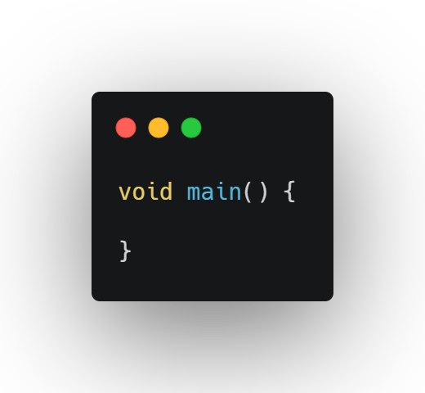
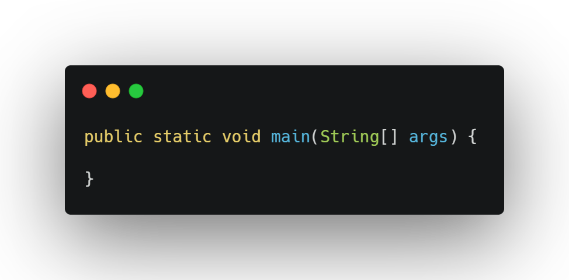
Entry Point
Dart
Java

Slide 6
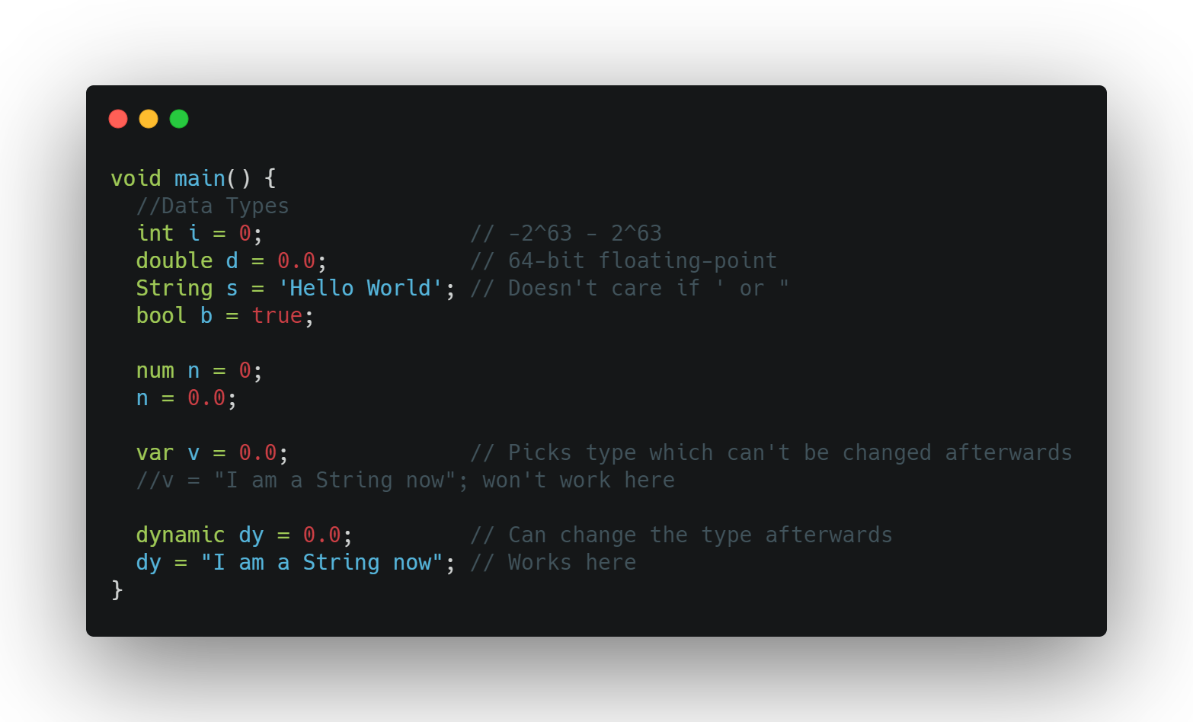
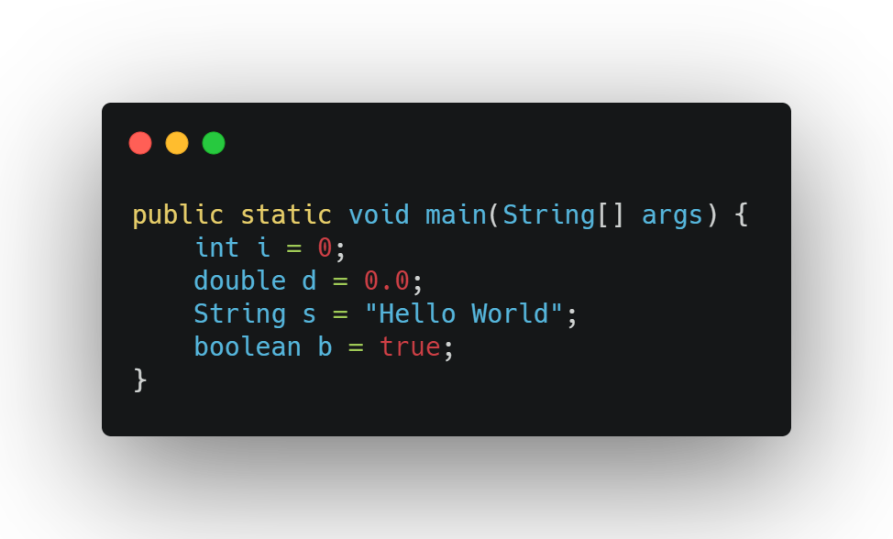
Data Types
Dart
Java
Notes:
Data Stype
There is no float type and bool is used instead of boolean
Dart can be typed dynamically or statically

Slide 7
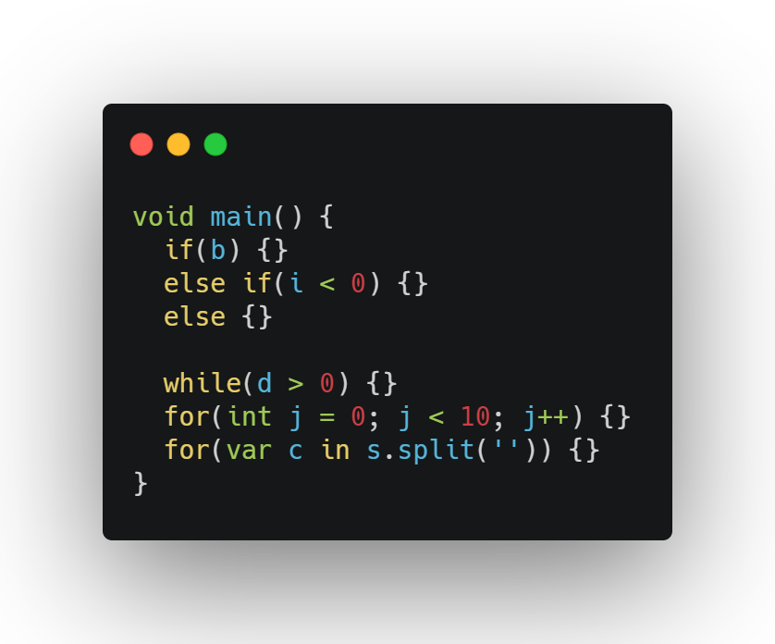
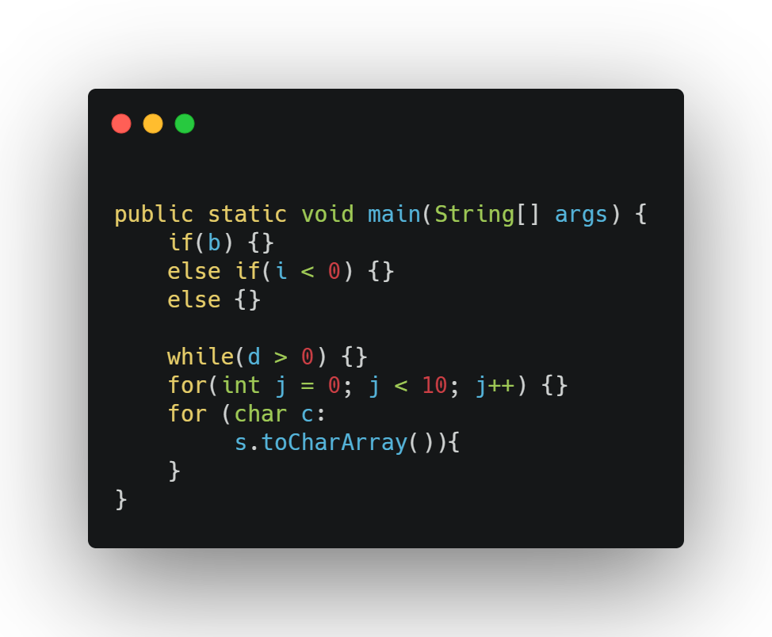
Conditionals
Dart
Java

Slide 8
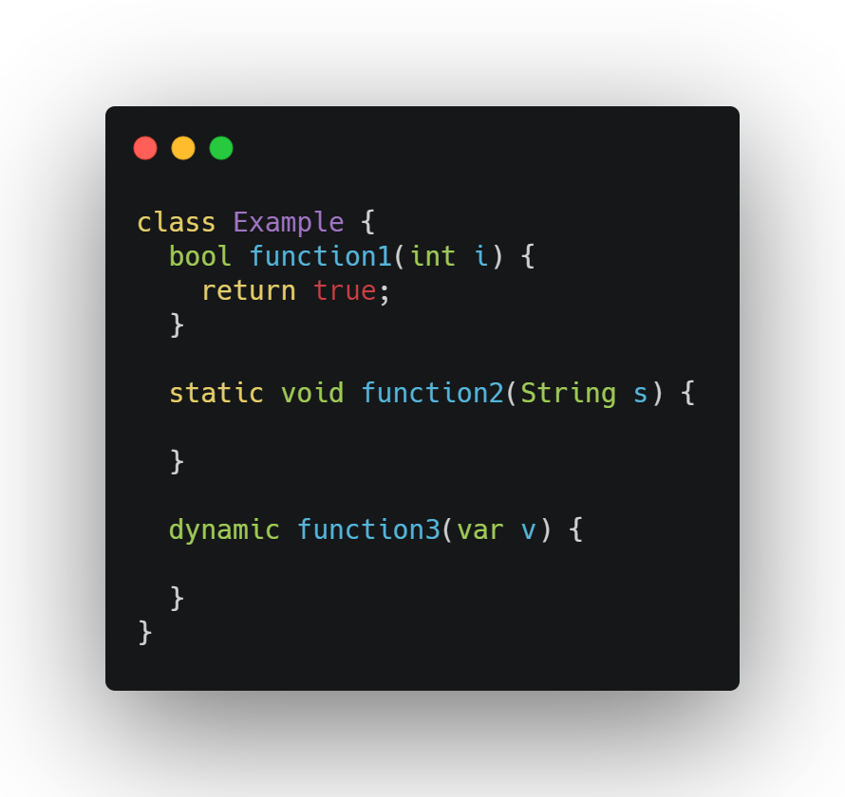
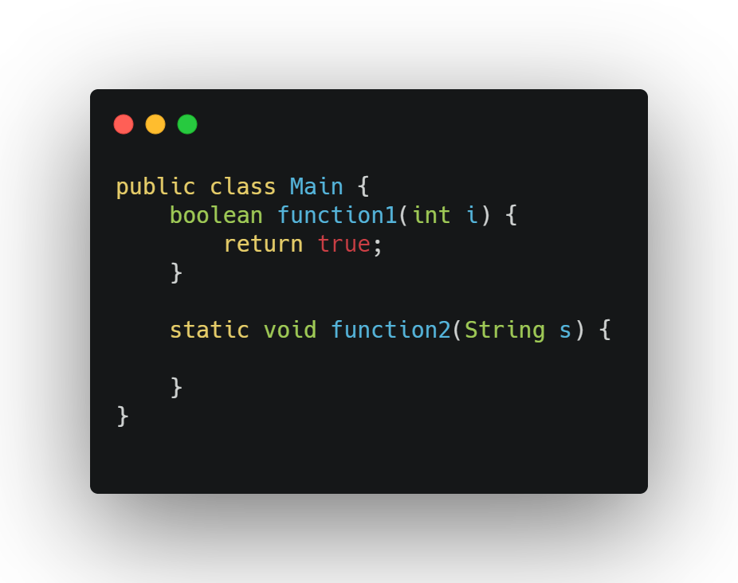
Functions
Dart
Java

Slide 9
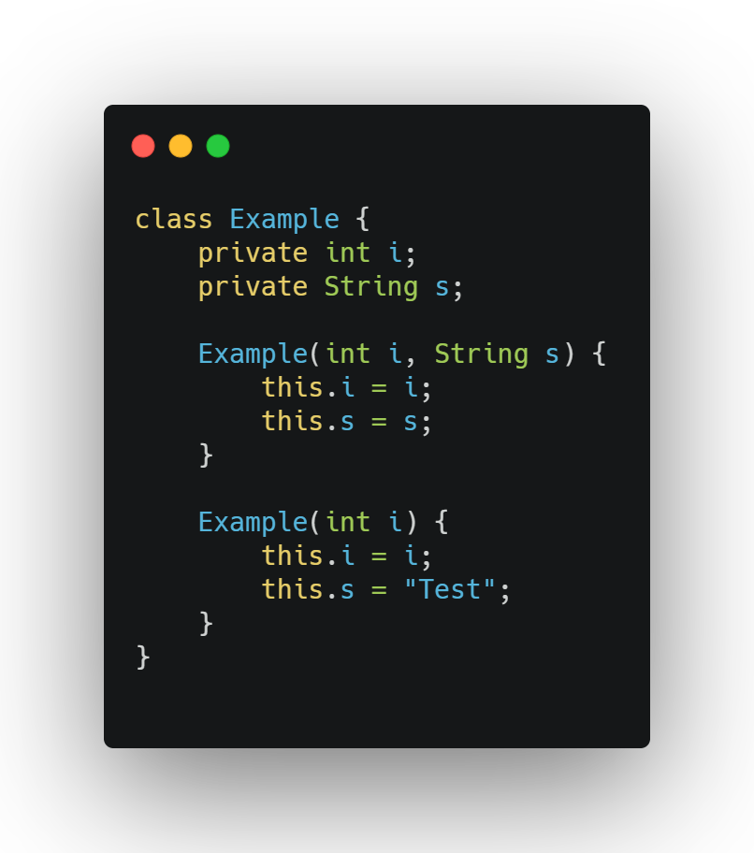
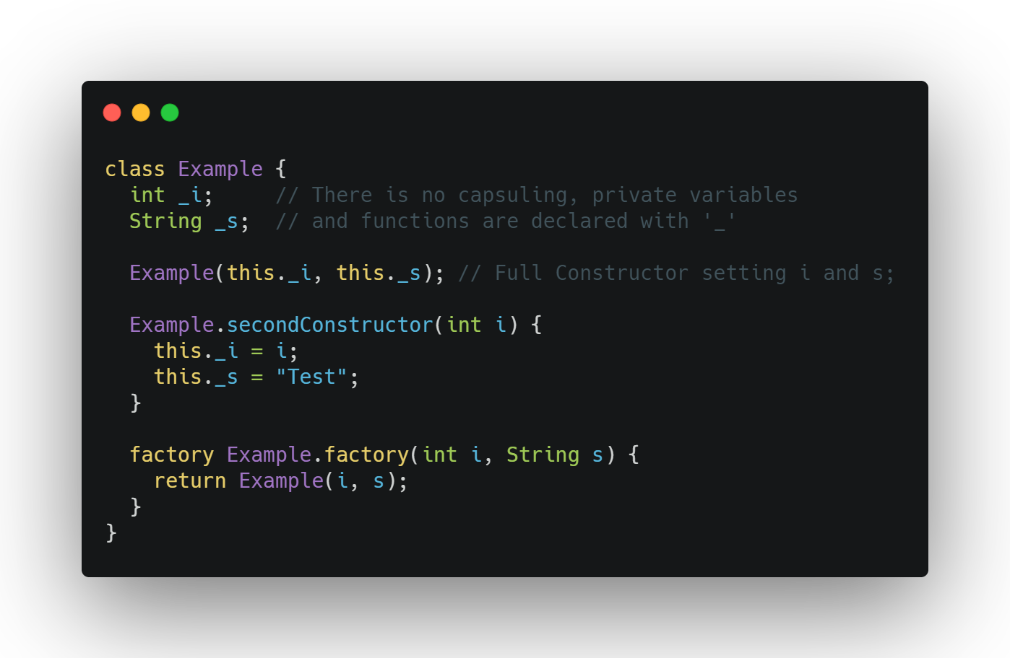
Classes
Dart
Java

Slide 10
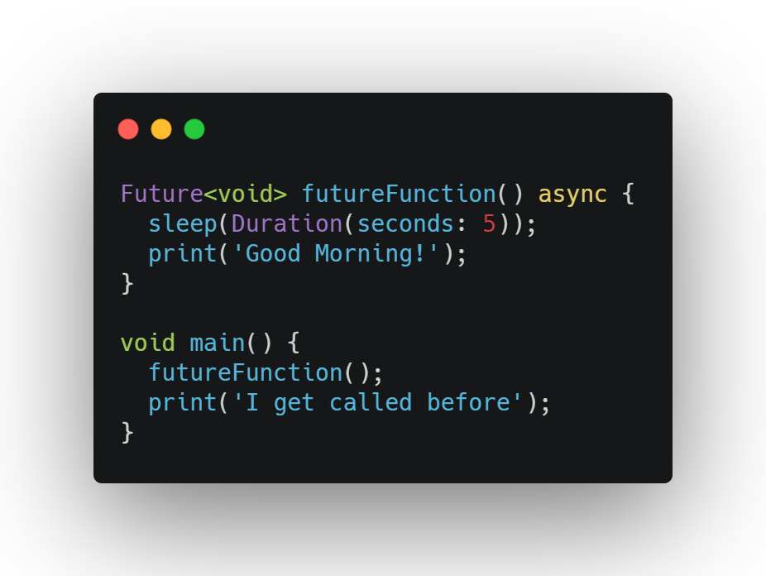
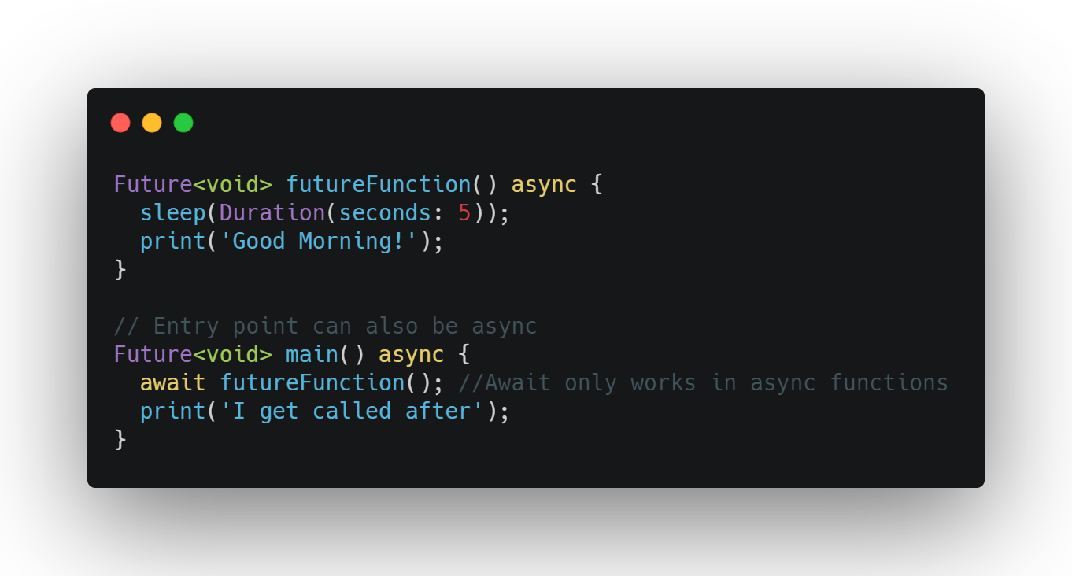
Dart Future
Async
Await

Slide 11
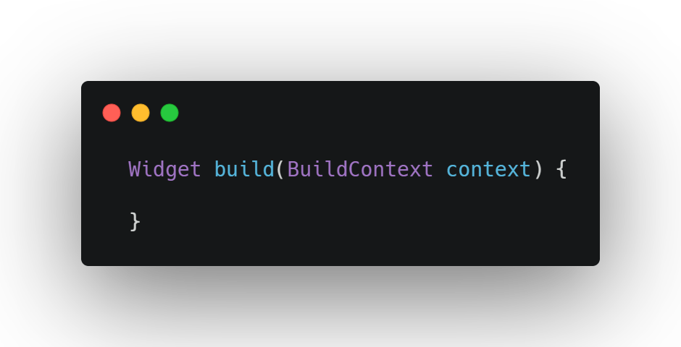
Widgets

Slide 12
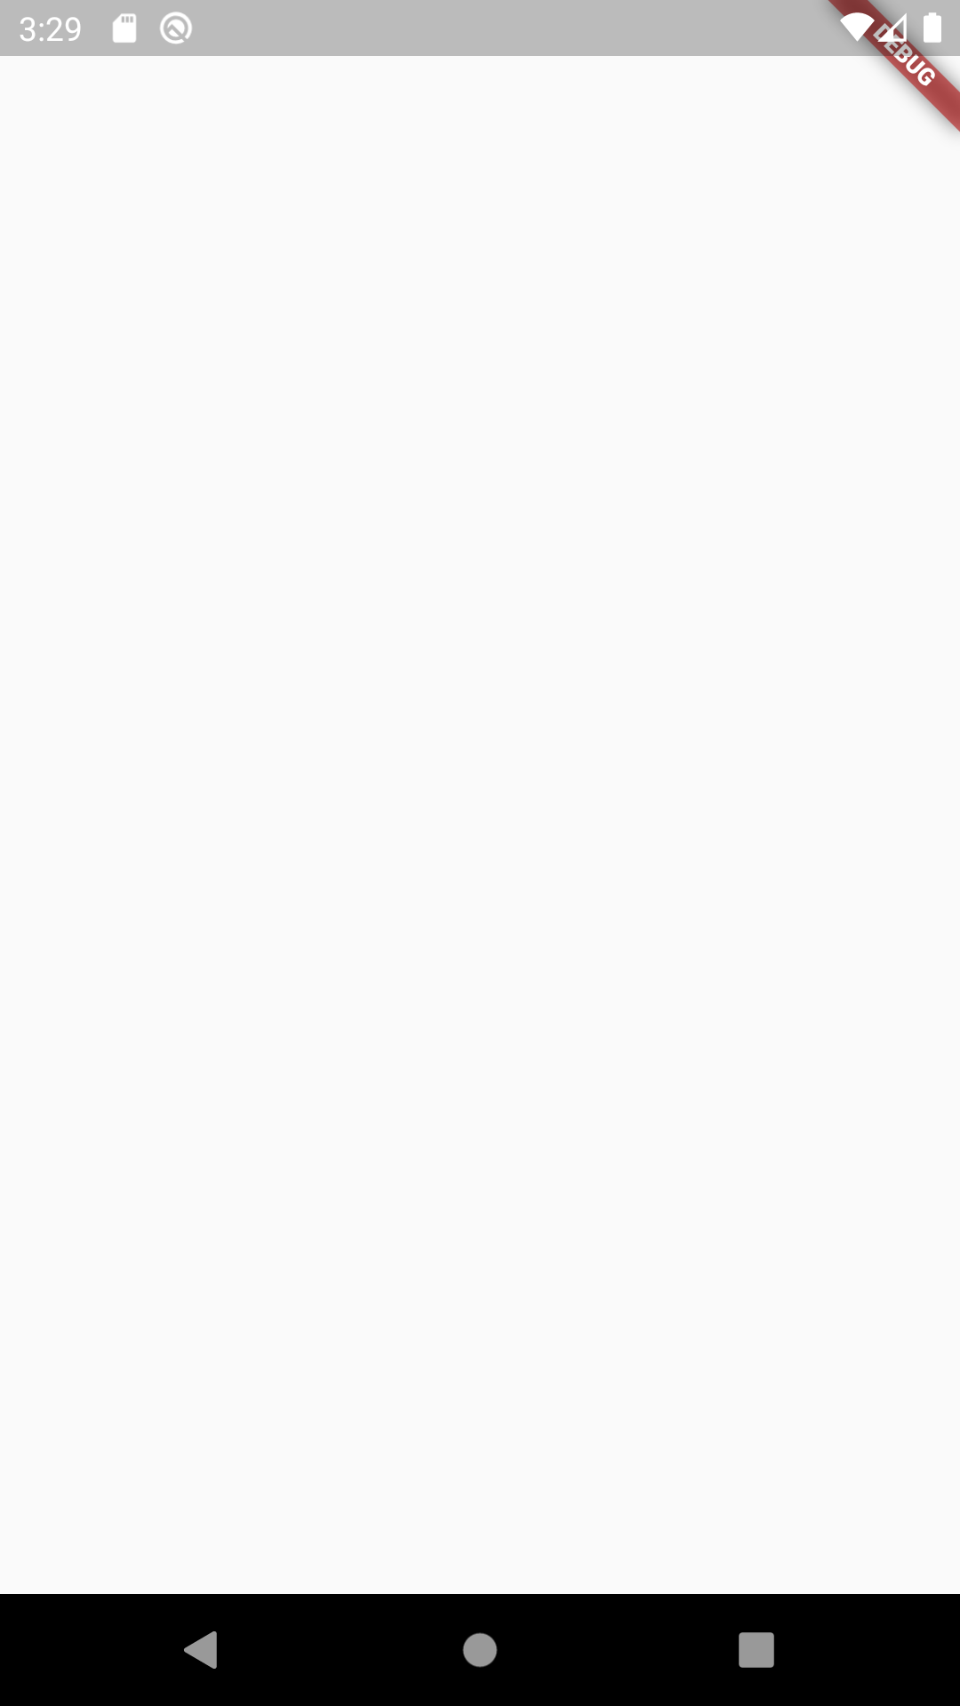
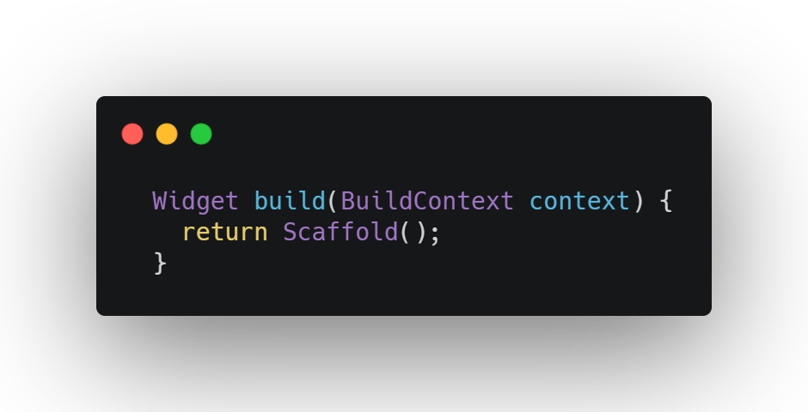
Widgets

Slide 13
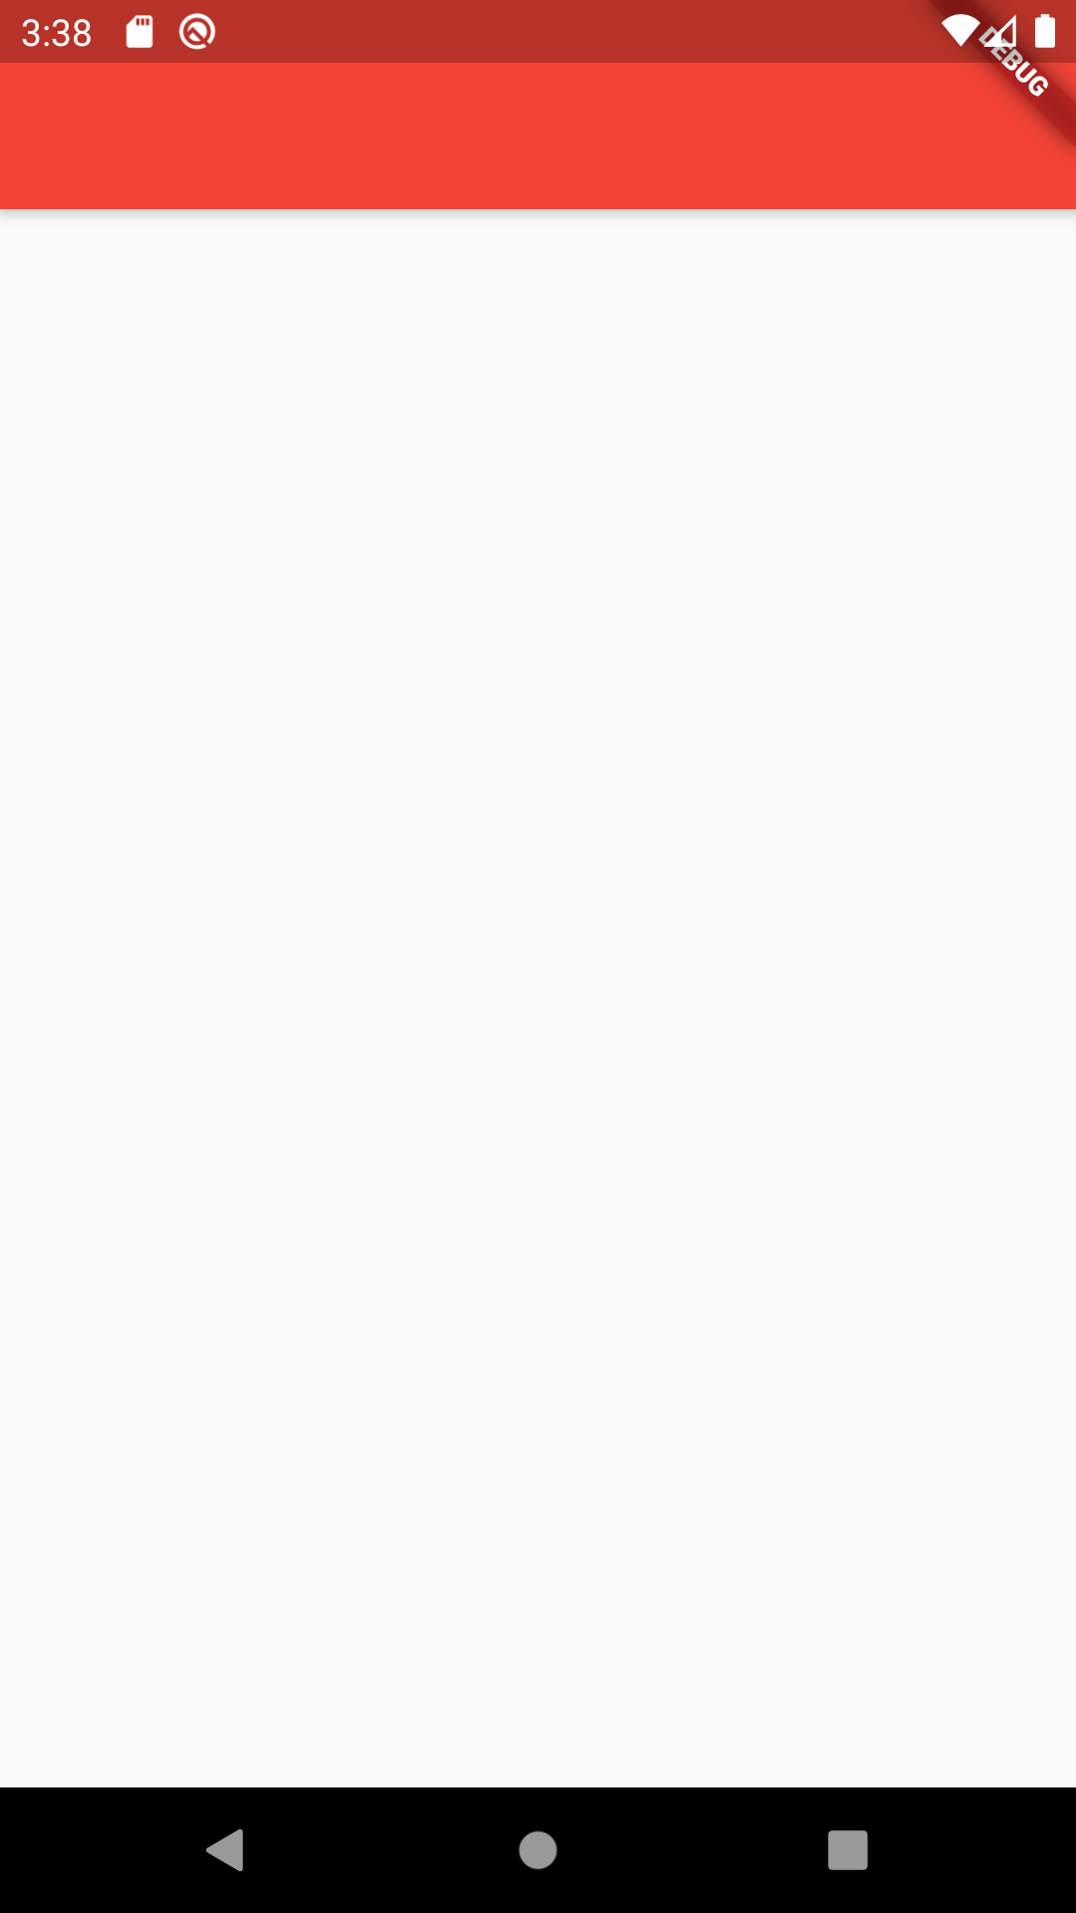
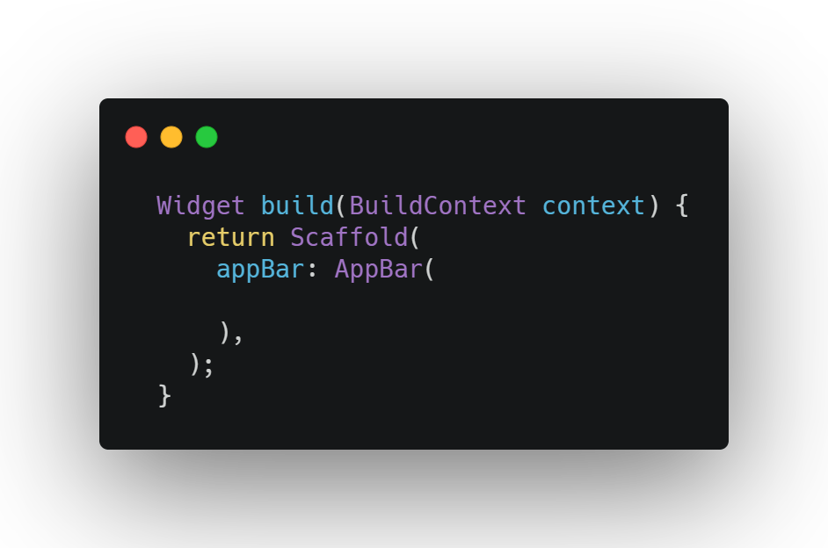
Widgets

Slide 14
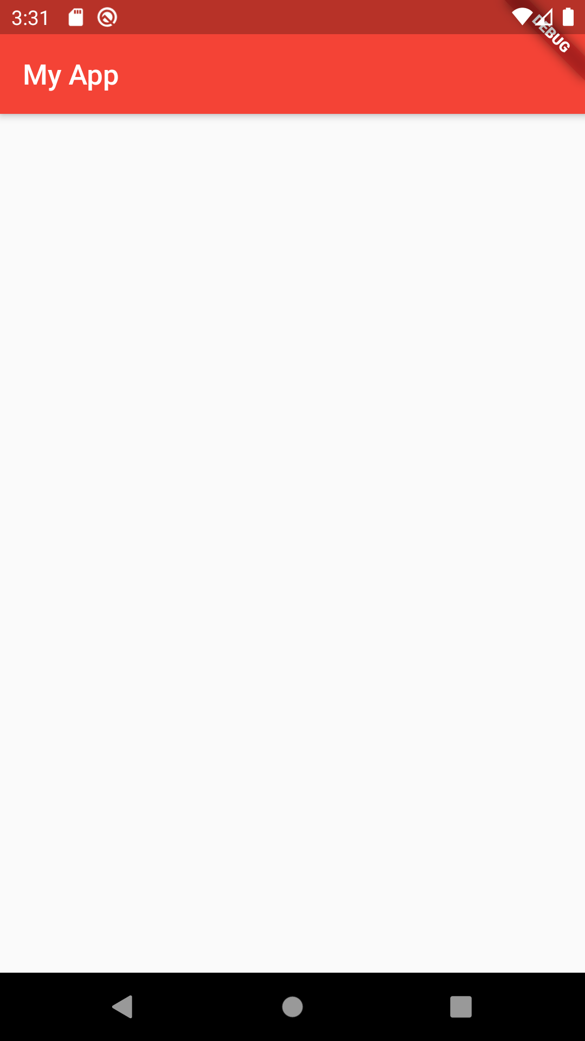
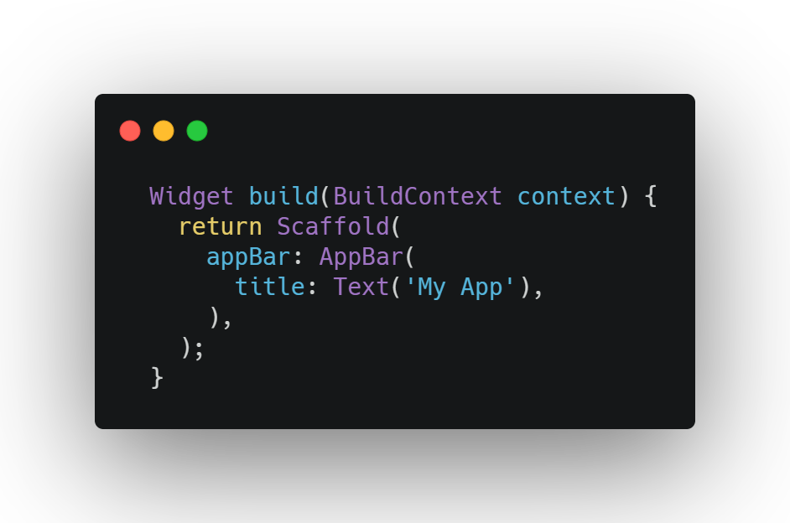
Widgets

Slide 15
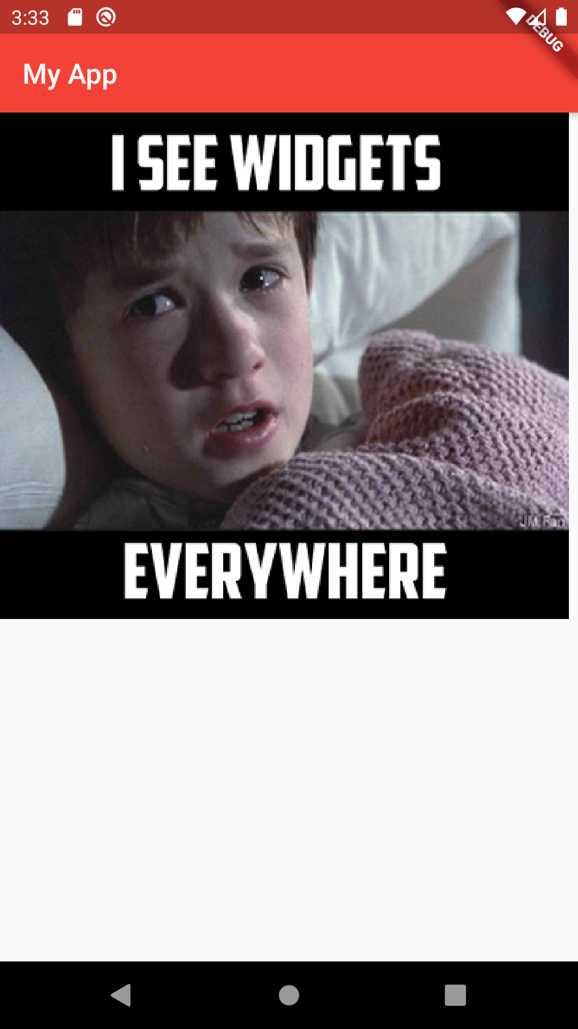
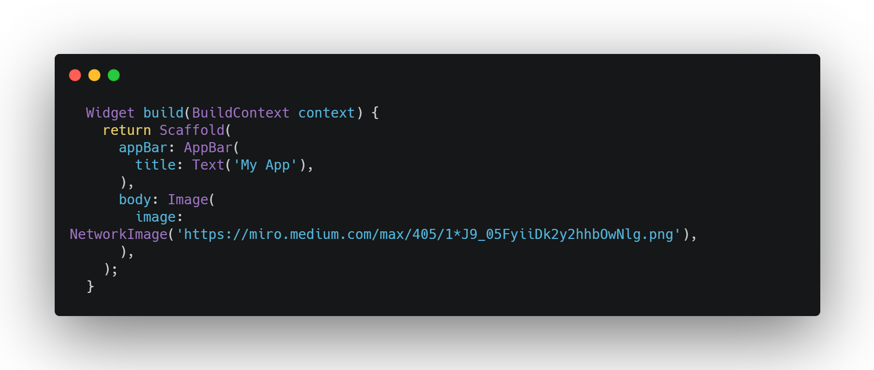
Widgets

Slide 16
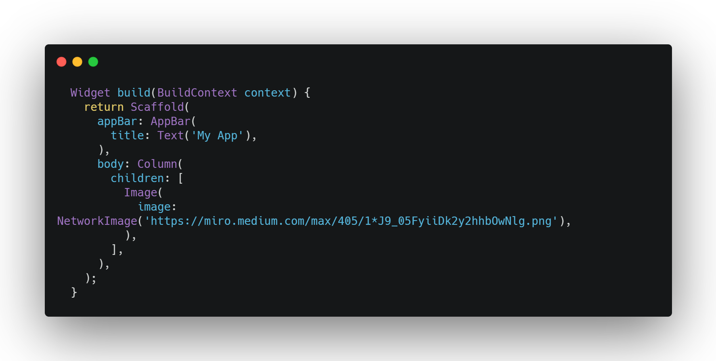
Widgets

Slide 17

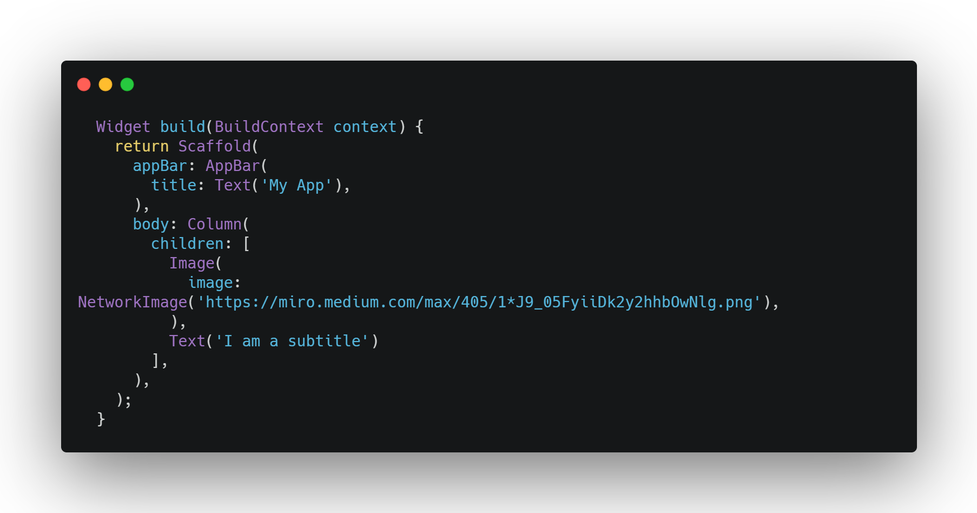
Widgets

Slide 18
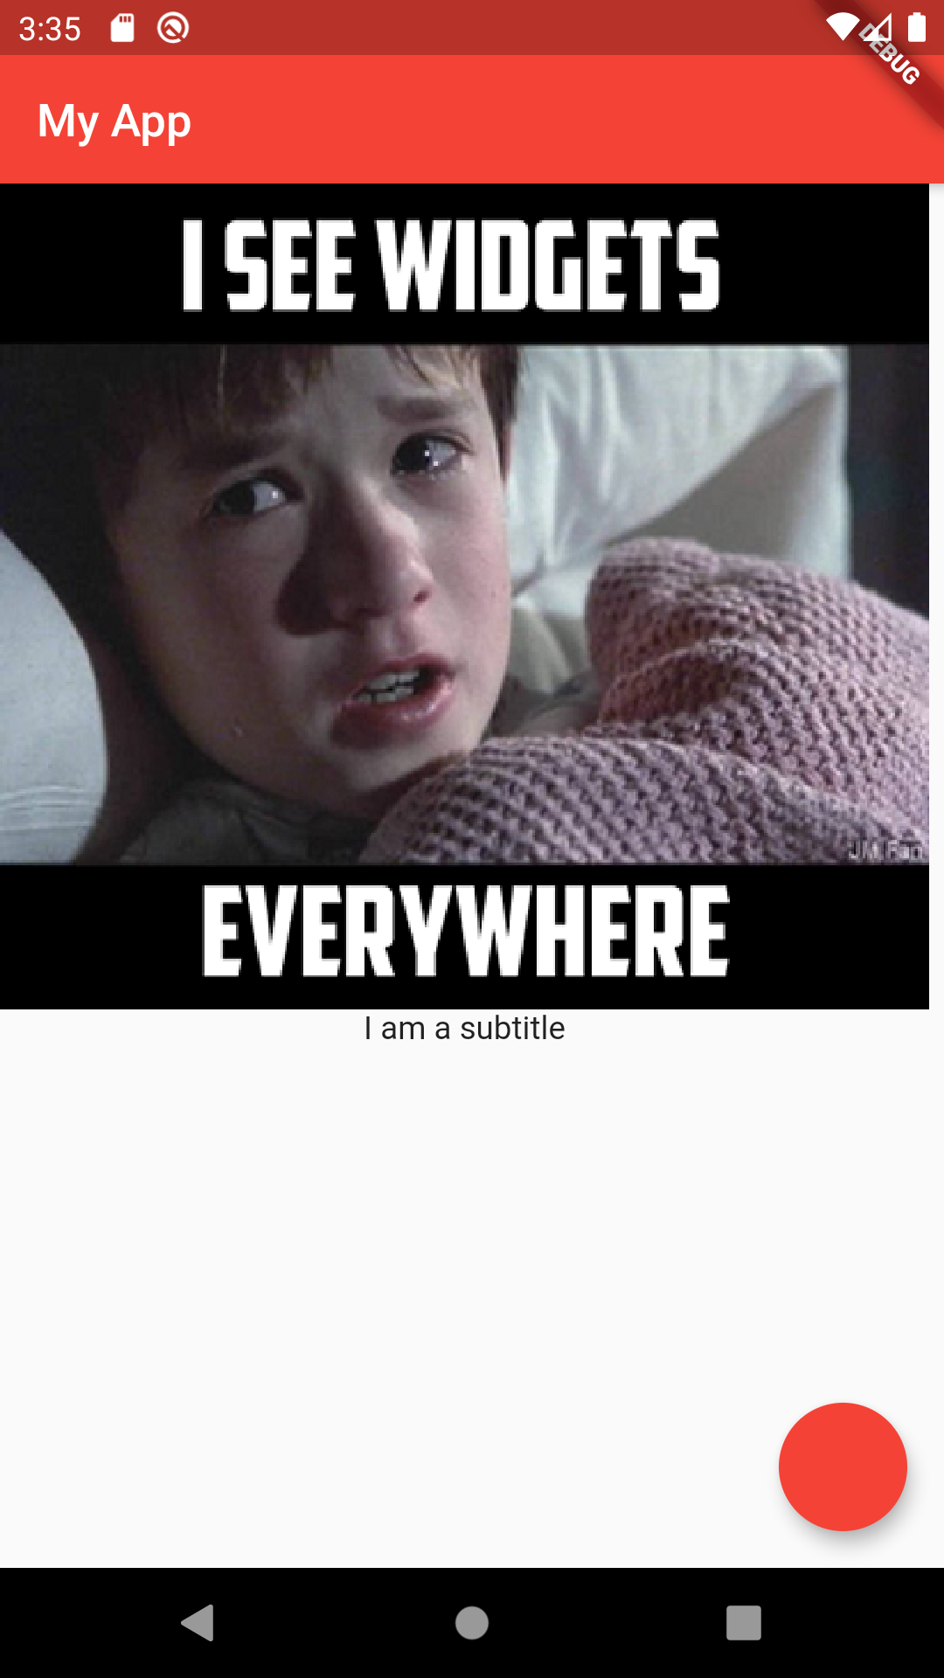
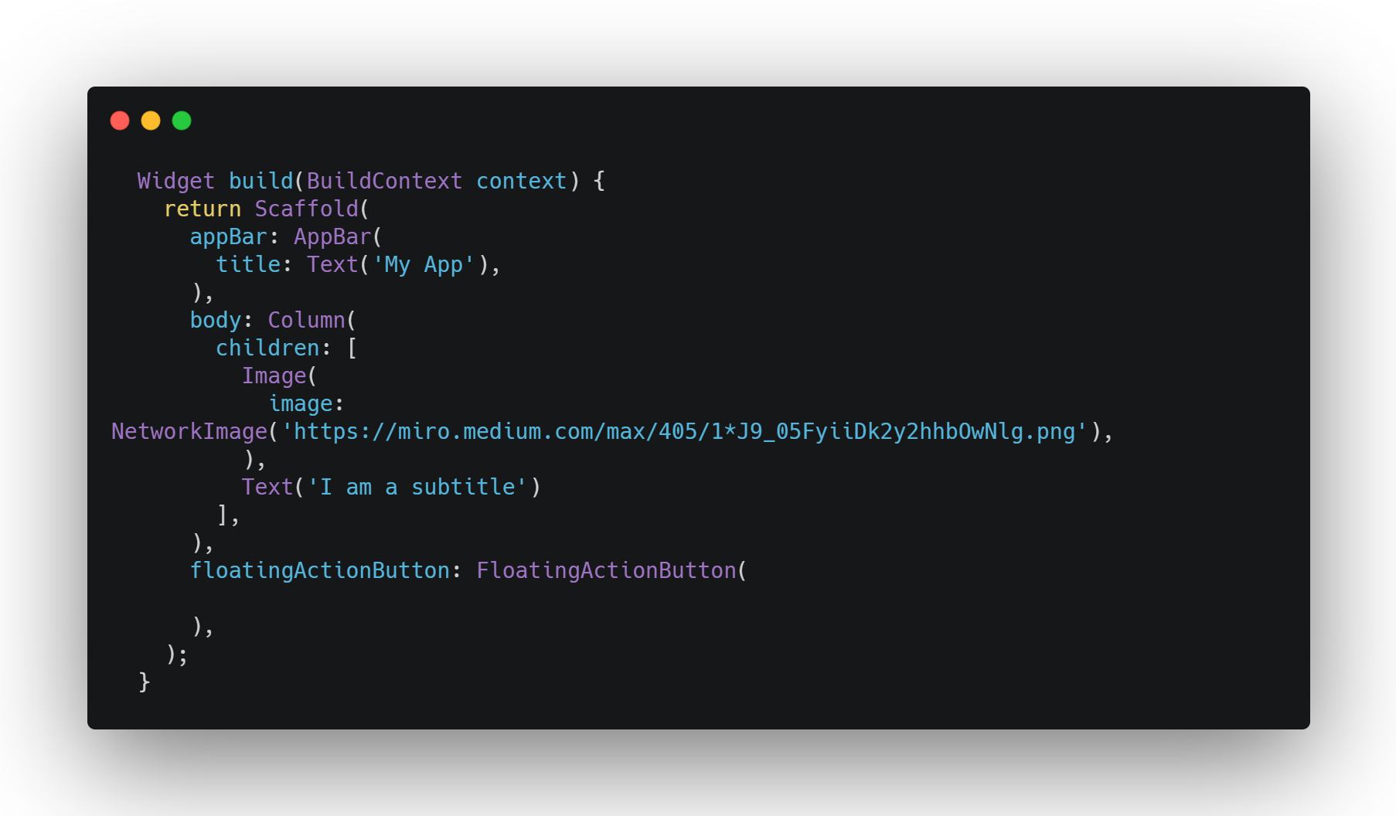
Widgets

Slide 19

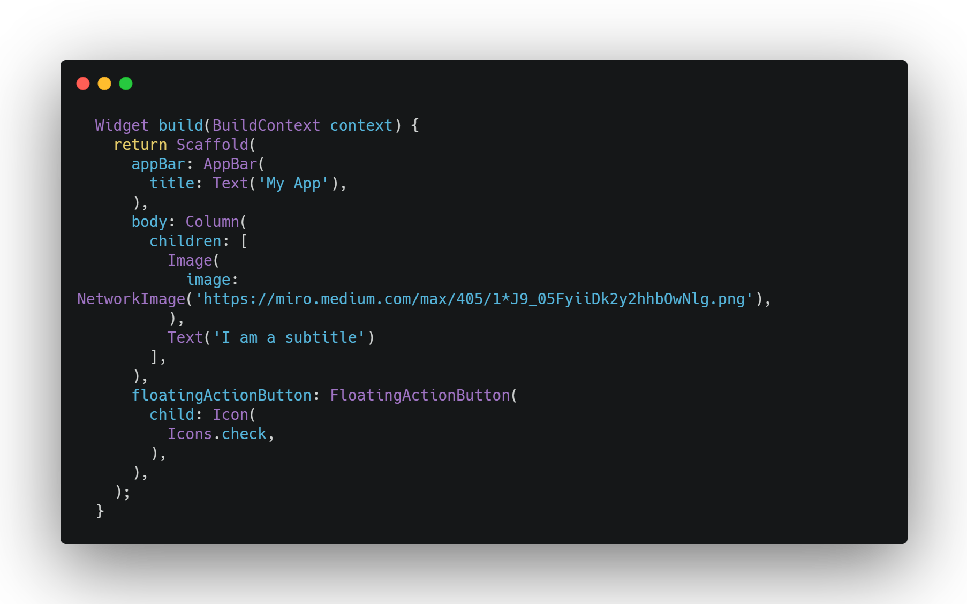
Widgets

Slide 20
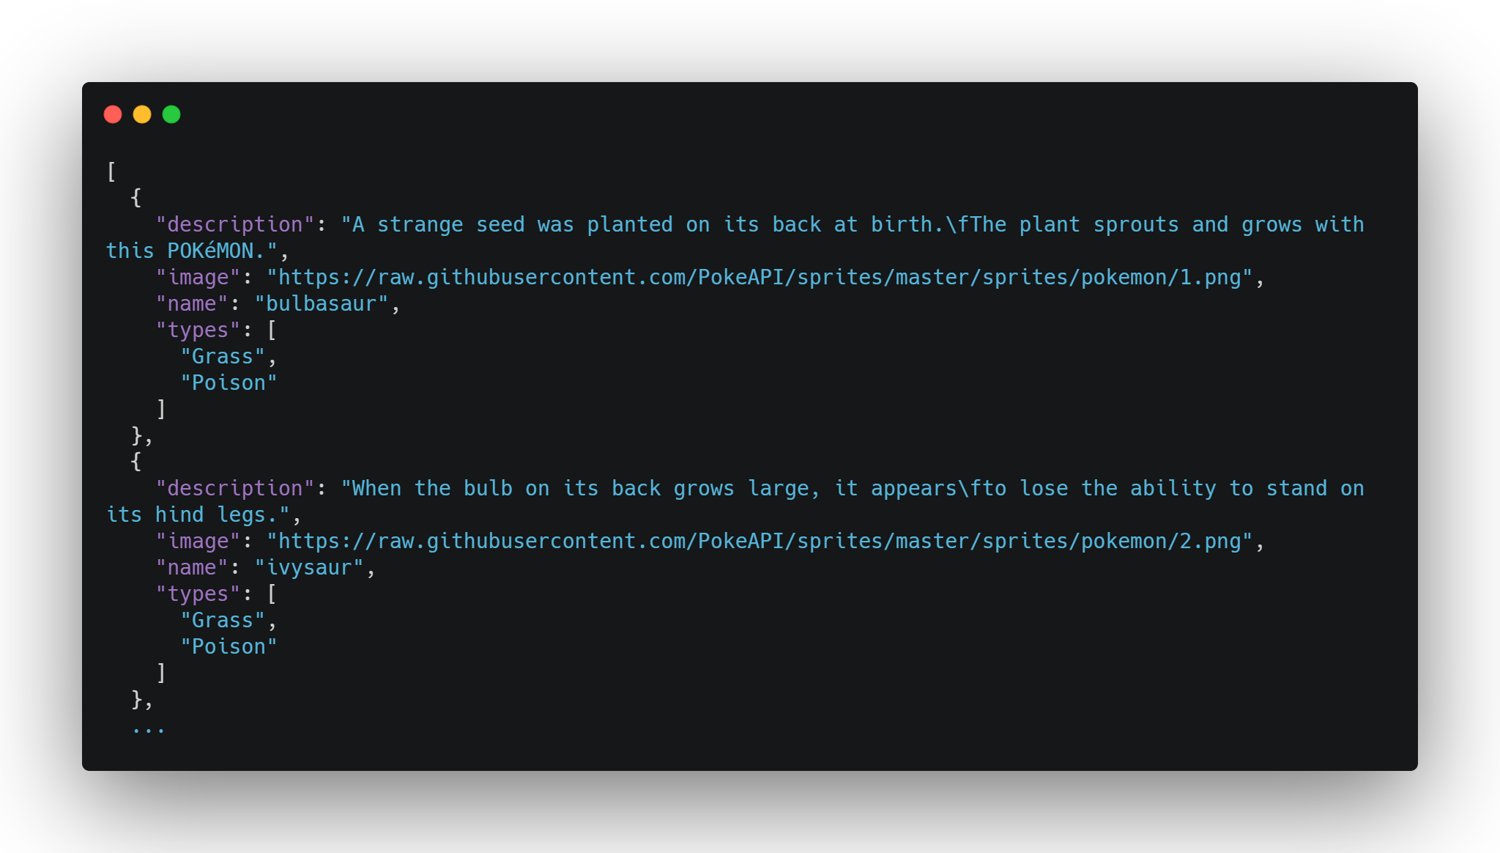

Demo
Because every 10 years old owns a phone anyway, maybe we could have an app for the Pokédex?
https://strong-thorn-planet.glitch.me/pokemon

Slide 21
Additional Information
https://flutter.dev/
https://glitch.com/
Practical Flutter by Frank Zammetti

